Slide 1

None of us really knew what we were doing, we just made it up as we went along.
Paul Thornton
paul@prtsystems.ltd.uk
UKNOF43
Manchester
9 April 2019
(Part 3 – Oh God, yes, there’s more)
We’re careering towards the end of the 1990s – what was happening in the UK Internet scene at the time?
Notes:
Do we know what we’re doing now?

Slide 2
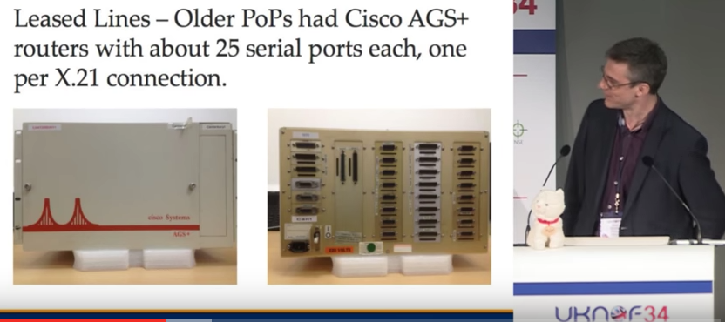
Previously at UKNOF34
What did the ISPs of the day offer?
How did they do it?
Whose kit did they use?
Did it even work?
PRTsystems
www.prtsystems.ltd.uk

Slide 3
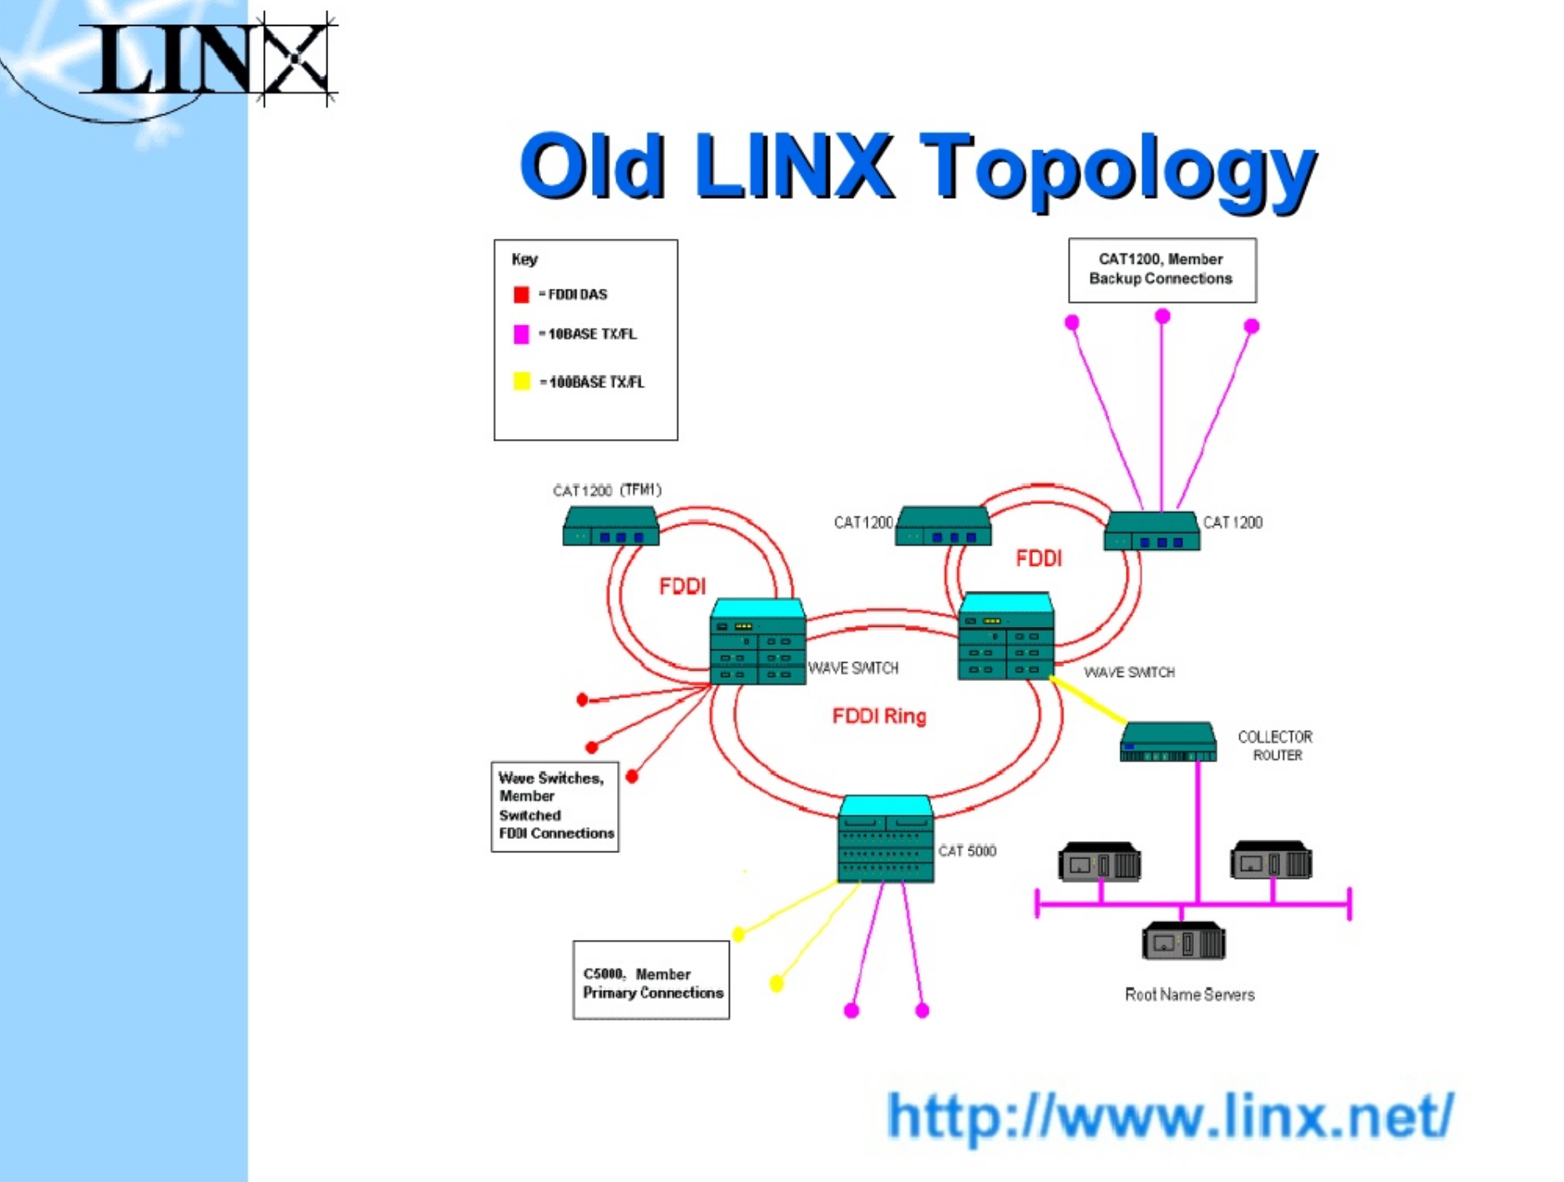
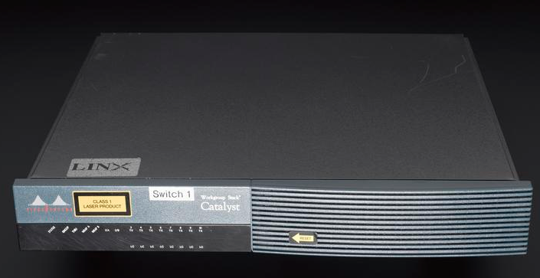
Previously at UKNOF37
IXPs needed more than 100M
The global routing table hit 50K routes!
FDDI wasn’t the answer to all any of our problems
Will this Internet thing make it to Y2K?
PRTsystems
www.prtsystems.ltd.uk

Slide 4
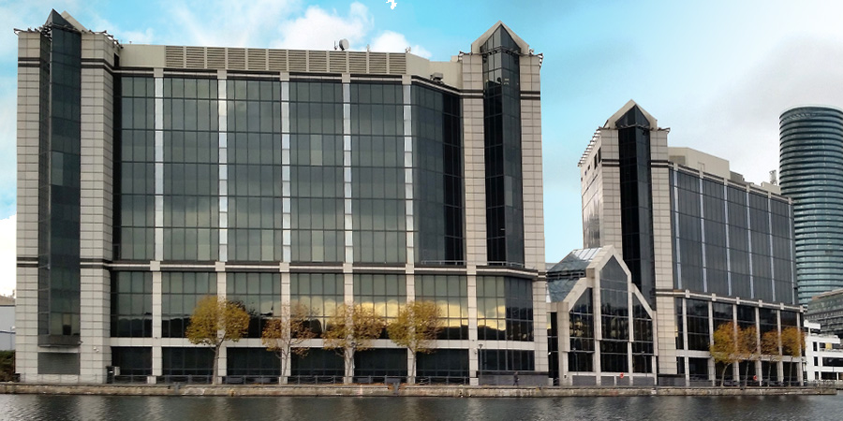
AS1290 (again)
I returned to PSINet in 1999 as part of the new datacentre engineering team at the new LHC.
PRTsystems
www.prtsystems.ltd.uk

Slide 5
Building a Datacentre - Tips
Don’t start with a mothballed office building that’s never been fitted out.
It won’t have enough riser space.
It certainly won’t have enough power.
But it was (apparently) cheap!
PRTsystems
www.prtsystems.ltd.uk

Slide 6
Building a Datacentre
So off we went, to see the PSINet flagship DC in Herndon.
PRTsystems
www.prtsystems.ltd.uk

Slide 7
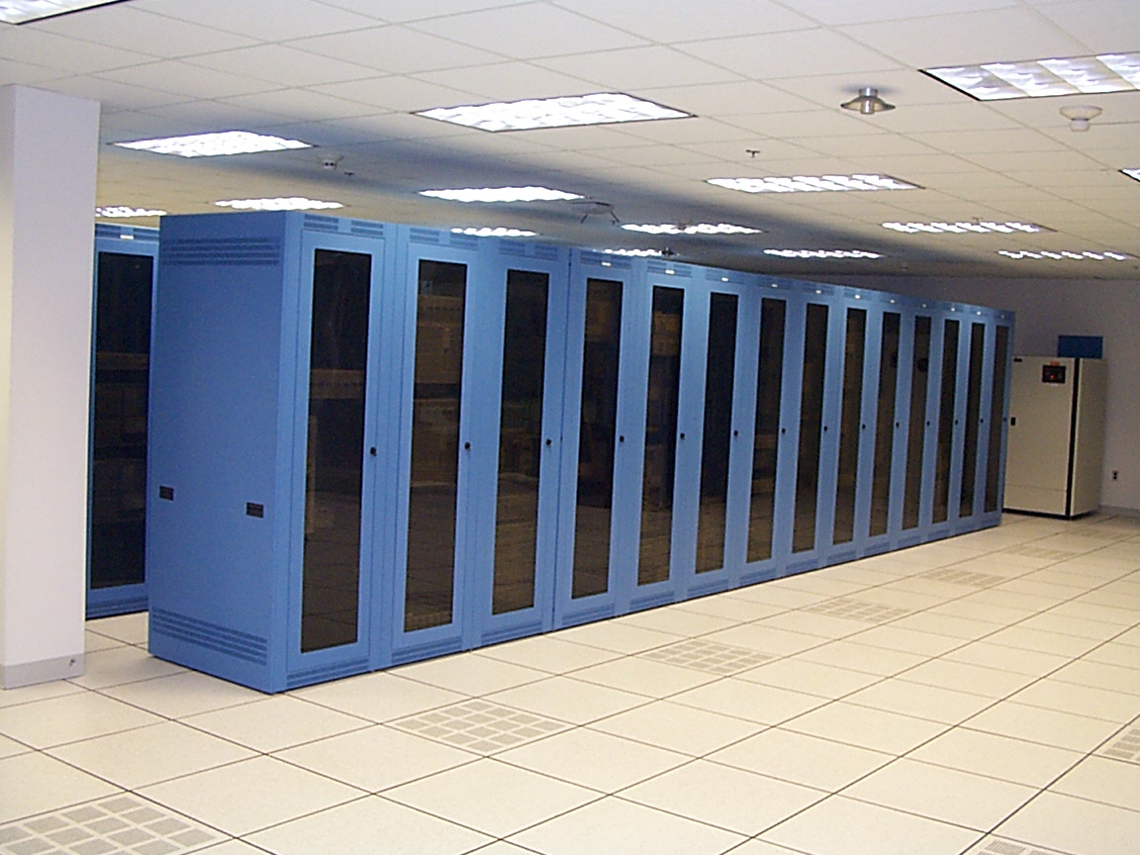
Building a Datacentre
So off we went, to see the PSINet flagship DC in Herndon.
It looked pretty decent...
PRTsystems
www.prtsystems.ltd.uk

Slide 8
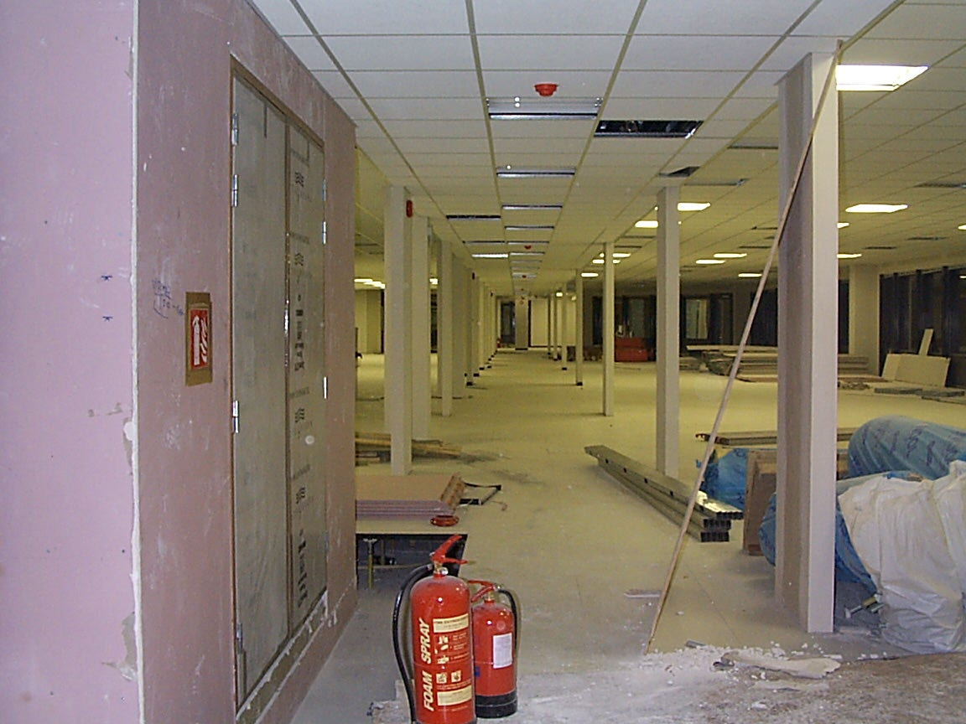
Building a Datacentre
We had this:
We were going to
need to speed up
the builders.
PRTsystems
www.prtsystems.ltd.uk

Slide 9
Building a Datacentre – Progress
We rapidly became involved in the DC fit out.
No good worrying about routers and servers if there wasn’t a floor or power.
But, naturally, sales had already sold things that we needed to deliver last week!
PRTsystems
www.prtsystems.ltd.uk

Slide 10
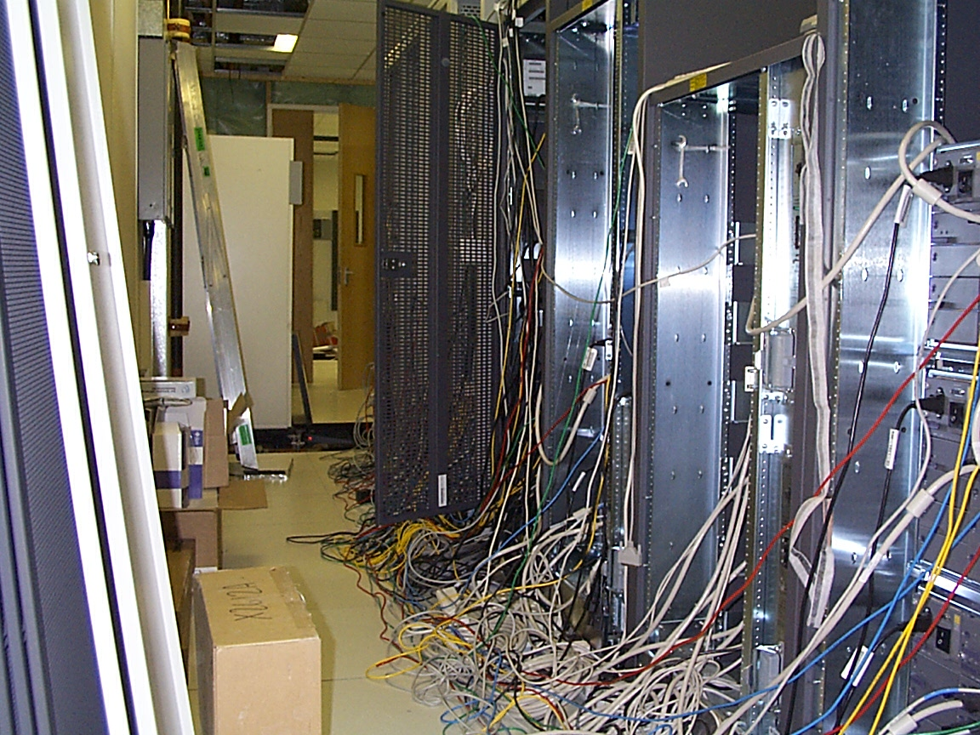
Building a Datacentre
BOO.com – the poster child of the .com era – sprawled messily over several racks in a temporary area.
PRTsystems
www.prtsystems.ltd.uk

Slide 11
Building a Datacentre
BOO.com – the poster child of the .com era – sprawled messily over several racks in a temporary area.
All of this kit needed to be professionally cleaned to remove dust – at great expense.
PRTsystems
www.prtsystems.ltd.uk

Slide 12
Building a Datacentre – Connectivity
What was the connectivity like?
Initially, a single 45M circuit back to Telehouse, terminated on a 7204. This was limiting.
Diverse dark fibre installed back to Telehouse but the LHC fibre PoP not ready for it (this was all in the days of expensive SDH kit).
PRTsystems
www.prtsystems.ltd.uk

Slide 13
Building a Datacentre – Connectivity
So we did what any impatient engineer would do...
I stole a pair of dark fibres and lit it at 1G Ethernet back to Telehouse. Connectivity at >45M solved for the time being.
The PSI fibre NOC were not happy that their fibre had been re-purposed, but they were in Canada so distance was on our side!
PRTsystems
www.prtsystems.ltd.uk

Slide 14
Building a Datacentre – Network
What was the network infrastructure?
DC design placed it in its own AS, as a downstream customer of PSI.
Cisco GSR (12000) as border routers.
Extreme switching layer below them.
PRTsystems
www.prtsystems.ltd.uk

Slide 15
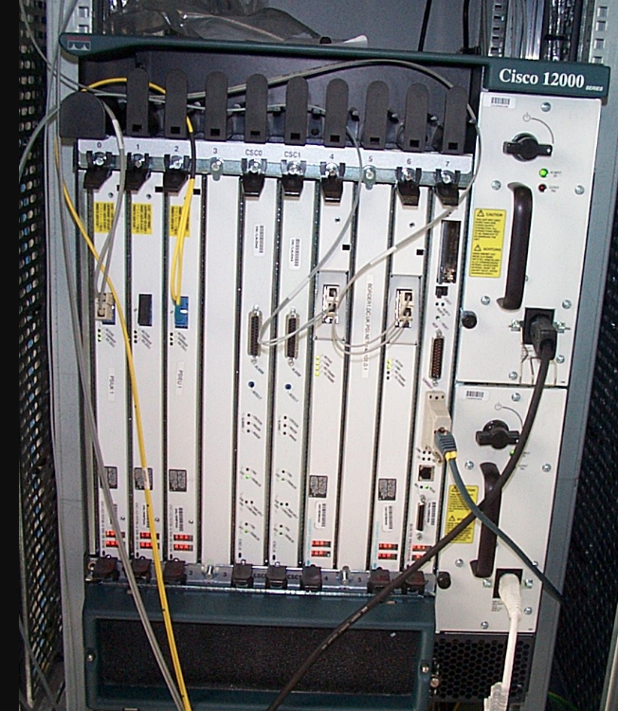
Building a Datacentre – Network
The GSR was a beast for the time – 2.4Gbit/sec capacity backplane.
PRTsystems
www.prtsystems.ltd.uk

Slide 16
Building a Datacentre – Network
The GSR was a beast for the time – 2.4Gbit/sec capacity backplane.
3x one port STM-4 cards
2x one port Gig-E cards
PRTsystems
www.prtsystems.ltd.uk

Slide 17
Building a Datacentre – Network
The GSR was a beast for the time – 2.4Gbit/sec capacity backplane.
3x one port STM-4 cards
2x one port Gig-E cards
Line cards had 2x 4 line dot-matrix displays.
Normally said IOS RUN
... but exposed in MIB ...
PRTsystems
www.prtsystems.ltd.uk

Slide 18
Building a Datacentre – Network
Extreme Summit 7i used as core switches.
We had the concept of ‘neighbourhoods’ of racks. For open colo areas, a Black Diamond provided lots of 10/100 Ethernet ports.
For dedicated web hosting areas, ToR switches (Summit 48) were used, with Summit 1i as aggregation layer.
PRTsystems
www.prtsystems.ltd.uk

Slide 19
Building a Datacentre – Network
Re-drawn from memory yesterday as I couldn’t locate anything original.
PRTsystems
www.prtsystems.ltd.uk

Slide 20
Building a Datacentre – Servers
Managed web servers were Cobalt Raq 2/3, HP Netservers or Sun 250/450.
PRTsystems
www.prtsystems.ltd.uk

Slide 21
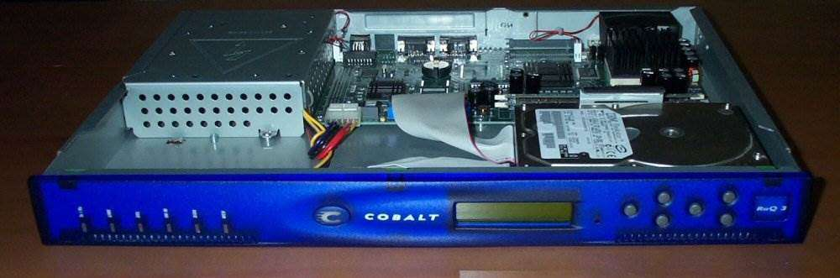
Building a Datacentre – Servers
Managed web servers were Cobalt Raq 2/3, HP Netservers or Sun 250/450.
PRTsystems
www.prtsystems.ltd.uk

Slide 22
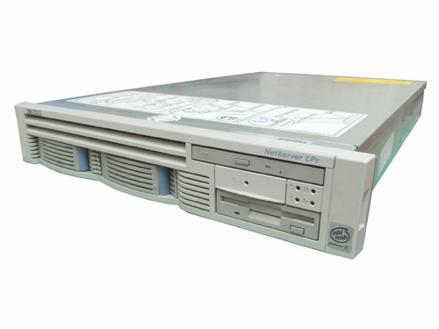
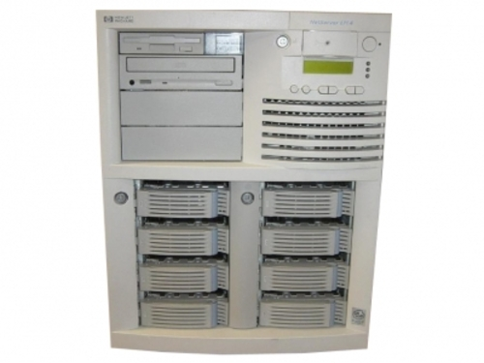
Building a Datacentre – Servers
Managed web servers were Cobalt Raq 2/3, HP Netservers or Sun 250/450.
PRTsystems
www.prtsystems.ltd.uk

Slide 23
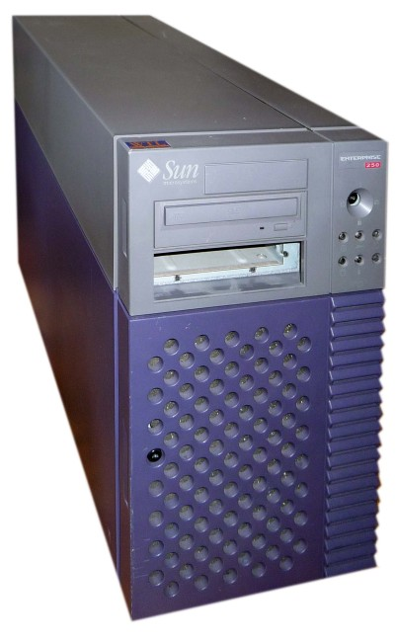
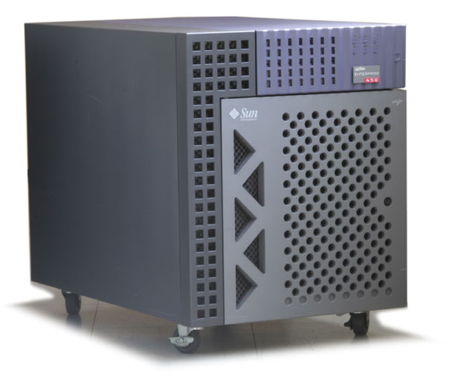
Building a Datacentre – Servers
Managed web servers were Cobalt Raq 2/3, HP Netservers or Sun 250/450.
PRTsystems
www.prtsystems.ltd.uk

Slide 24
Building a Datacentre – Servers
Managed web servers were Cobalt Raq 2/3, HP Netservers or Sun 250/450.
Customers offered choice of Red Hat Linux or Windows NT on the HP Netservers.
Load balancing, if required, was F5.
Customer firewalls were Checkpoint/Nokia.
PRTsystems
www.prtsystems.ltd.uk

Slide 25
Building a Datacentre
No-one had thought of extra office space or development space for the engineering team.
PRTsystems
www.prtsystems.ltd.uk

Slide 26
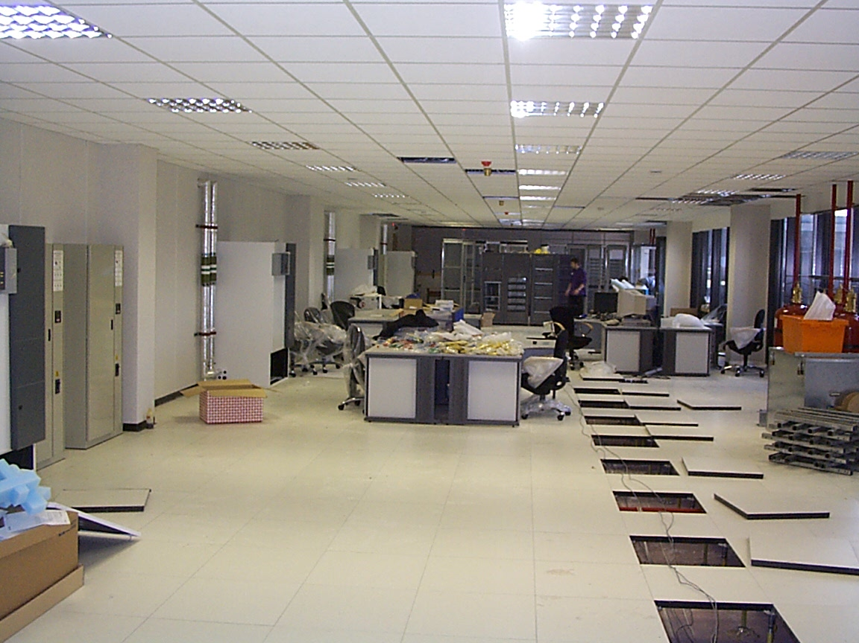
Building a Datacentre
So we built our own on the DC floor.
PRTsystems
www.prtsystems.ltd.uk

Slide 27
Building a Datacentre
So we built our own on the DC floor.
At current Equinix prices, that desk space would be about £60K per month including cross connects!
PRTsystems
www.prtsystems.ltd.uk

Slide 28
Building a Datacentre – The fun
Film crews were an unexpected bonus
The boat chase scene near the start of The World Is Not Enough came through Millwall dock.
Watched from the LHC roof whilst a stuntman dressed as James Bond exceeded the speed limit on the dock.
PRTsystems
www.prtsystems.ltd.uk

Slide 29
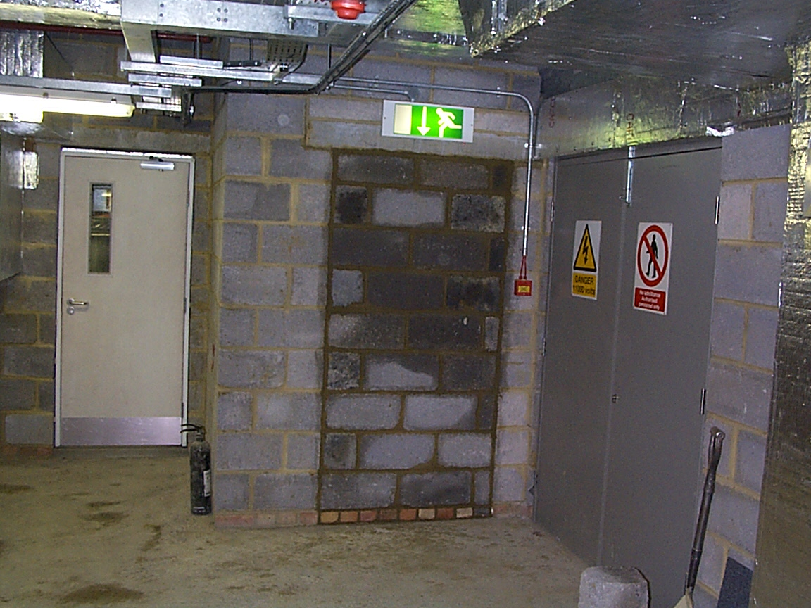
Building a Datacentre – The fun
Sums it all up – there is no escape for you.
PRTsystems
www.prtsystems.ltd.uk

Slide 30
Building a Datacentre – Opening
Finally officially opened in July 1999
Official opening required a maintenance staff member sitting on the roof of the lift car to ensure it didn’t get stuck and incarcerate senior execs from the US.
We finally ironed most of these problems out by the end of the year.
PRTsystems
www.prtsystems.ltd.uk

Slide 31
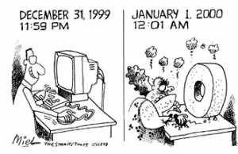
Y2K
The endless What If discussions with consultants during 1999.
Like many others, we were more worried about 2038 than 19100 2000.
What happened on
new year’s eve?
PRTsystems
www.prtsystems.ltd.uk

Slide 32
Y2K
The LINX staged a conference bridge for members from around 2230 UTC on 1999-12-31.
I was on it.
By ten past midnight, we’d resorted to discussing the Queen’s hat to pass the time.
All that planning clearly paid off.
PRTsystems
www.prtsystems.ltd.uk

Slide 33

Football
PSINet were a global sponsor of Euro 2000
This was the first time a major sporting event had a “useful” website.
PRTsystems
www.prtsystems.ltd.uk

Slide 34
Football
Due to the restrictive broadcast rights, there was no streaming video or audio.
There was a text running commentary though; plus match fixtures, reports and background information.
Globally load-balanced across 5 PSINet DCs/PoPs
PRTsystems
www.prtsystems.ltd.uk

Slide 35
Football
DNS-based load balancing with F5 Big IP global traffic manager.
Local load balancing used Arrowpoint boxes.
If I recall correctly, we had some very early adoption of anycast for some server IP addresses across PSI’s network.
PRTsystems
www.prtsystems.ltd.uk

Slide 36
Football
A whopping 1Gbit/sec of total capacity available.
PRTsystems
www.prtsystems.ltd.uk

Slide 37
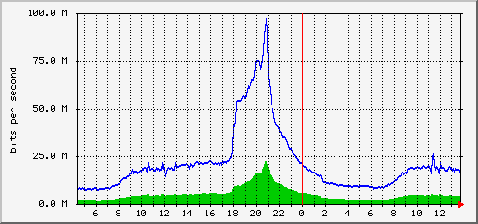
Football
A whopping 1Gbit/sec of total capacity available.
And it used just under 100Mbit/sec
PRTsystems
www.prtsystems.ltd.uk

Slide 38
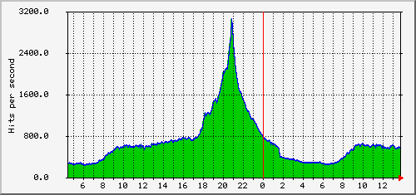
Football
A whopping 1Gbit/sec of total capacity available.
Peak web traffic was ~3k hits /sec.
PRTsystems
www.prtsystems.ltd.uk

Slide 39
Football
A whopping 1Gbit/sec of total capacity available.
This traffic peak was at half-time during the France vs Holland semi-final...
PRTsystems
www.prtsystems.ltd.uk

Slide 40
Football
A whopping 1Gbit/sec of total capacity available.
This traffic peak was at half-time during the France vs Holland semi-final...
All of the NOC engineering staff attended this match, I monitored network status on a Nokia Communicator by my feet.
PRTsystems
www.prtsystems.ltd.uk

Slide 41
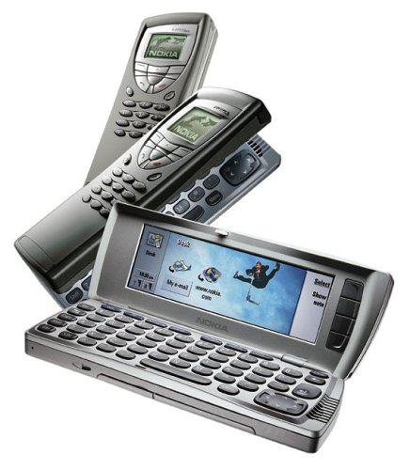
Football
For those of you who can’t (or won’t) remember...
... This is a Nokia 9210 Communicator.
PRTsystems
www.prtsystems.ltd.uk

Slide 42
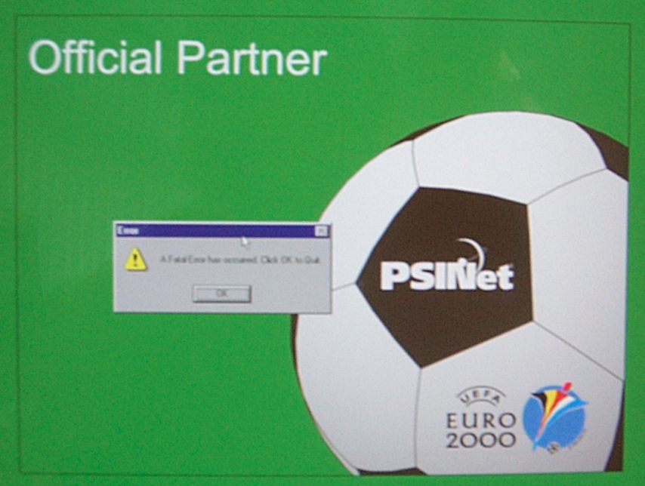
Metaphors for things to come?
That message reads: “A fatal error has occurred”
PRTsystems
www.prtsystems.ltd.uk

Slide 43
Metaphors for things to come?
Demonstrating that once again, PSINet were ahead of the pack, PSI Inc. filed for chapter 11 bankruptcy protection in June 2001.
PRTsystems
www.prtsystems.ltd.uk

Slide 44
Metaphors for things to come?
Demonstrating that once again, PSINet were ahead of the pack, PSI Inc. filed for chapter 11 bankruptcy protection in June 2001.
Rumours that this was caused by my expenses claims whilst working for them in Australia are greatly exaggerated.
PRTsystems
www.prtsystems.ltd.uk

Slide 45

Any Questions?
This series of presentations, diagrams, router configurations and other tidbits I managed to locate can be found at:
http://www.prt.org/history
Remember, folks, AS174 has been the go-to AS for your peering spats for over two decades.
PRTsystems
www.prtsystems.ltd.uk

Slide 46

Thank you
Paul Thornton
paul@prtsystems.ltd.uk
UKNOF37
Manchester
20 April 2017
PRTsystems

