Slide 1
None of us really knew what we were doing, we just made it up as we went along.
Paul Thornton
paul@prtsystems.ltd.uk
UKNOF34
Manchester
21 April 2016
(Part 1 – There may be more)
A lighthearted and hopefully informative meander around bits of the UK Internet in 1996 (ish)
Notes:
Do we know what we’re doing now?

Slide 2
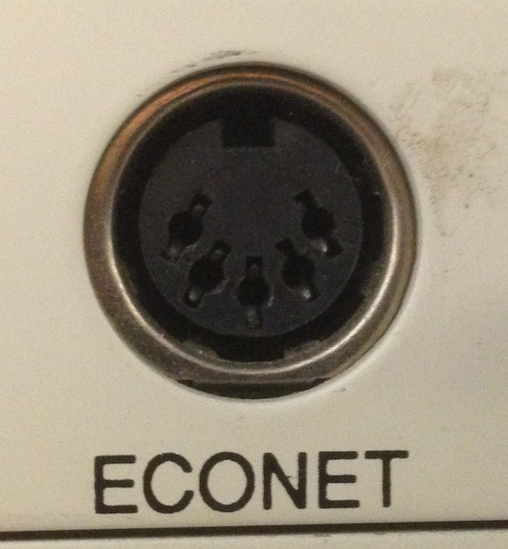
The Pre-History
How did I end up doing this?
Blame Acorn...
I ended up working at SJ Research during and after university. They made file servers for Acorn machines; and then were instrumental in the Cambridge IPTV over ATM trial.
PRTsystems
www.prtsystems.ltd.uk
Notes:
Immediately saw the power of interconnected computers in the mid 1980s – model Bs sharing discs and printers.
Cambridge Interactive TV trial. Doing X over E1 over ATM.
SJ however, went bust. So off I went to PSINet after an interview where I assured them I knew about all of these protocols they mentioned (BGP, EGP, RIP, Frame Relay and more) – and then spent several days reading in the Sussex Uni library to at least be able to have a conversation about them. Luckily, I was in at the deep end on day one, and after a few weeks of blundering got the hang of it.
Astute followers will note that this is an A5000 Econet socket. I wanted a BBC Micro one, but my BBC micros are all in a box under a pile of immobile junk and getting one out just for a photo opportunity is too much like hard work. I have an A5000 on the desk next to me at the moment, so that’s what you’re getting.

Slide 3
But First: IP? What’s IP
In my 2nd year at university, things changed from X25 to IP. This was most frustrating as I’d just started to properly understand the big-endian way of the world when it all changed.
I did however keep a tie to the past: My X.400 based E-mail address at home - A sister company of SJ Research (Interspan) ran a mail system for schools that dialed lots of modems overnight to collect and deliver mail.
PRTsystems
www.prtsystems.ltd.uk
Notes:
IP did, after some thought, make much more sense though.

Slide 4
The Magic of mhs-relay
Unfortunately E-mail addressing wasn’t exactly standard in the 1990s. We had: UUCP, X.400, JANET and Internet addresses all trying to communicate with each other.
The solution: stick “@mhs-relay.ac.uk” on the end and 99% of the time, it would sort it out for you.
On the rare occasions it didn’t, the resulting bounce message was normally breathtaking.
PRTsystems
www.prtsystems.ltd.uk
Notes:
A small aside.
Or uk.ac.mhs-relay depending on whether your local MTA preferred its ends big or little.
Thank you JANET for the relay abuse you endured from me during my youth!

Slide 5
The Magic of mhs-relay
This did, however, lead to some fairly ugly headers:
Via: UK.AC.MHS-RELAY; Fri, 14 May 93 1:34 BST
X400-Received: by mta sun2.mhs-relay.ac.uk in /PRMD=uk.ac/ADMD= /C=gb/; Relayed;
Fri, 14 May 1993 01:34:15 +0100
X400-Received: by /ADMD=INTERSPAN/C=GB/; Relayed;
Fri, 14 May 1993 11:25:18 +0100
Date: Fri, 14 May 1993 11:25:18 +0100
X400-Originator: /G=Paul/S=Thornton/O=PRT-HOME/ADMD=INTERSPAN/C=GB/@uk.ac.mhs-relay
X400-Recipients: zhap019@uk.ac.rhbnc.vax
X400-MTS-Identifier: [/ADMD=INTERSPAN/C=GB/;ARM358-910514102528-2F56B706]
X400-Content-Type: P2-1984 (2)
From: /G=Paul/S=Thornton/O=PRT-HOME/ADMD=INTERSPAN/C=GB/@uk.ac.mhs-relay
Message-ID: <ARM358-910514102528-2F56B706*@MHS>
To: zhap019@uk.ac.rhbnc.vax
PRTsystems
www.prtsystems.ltd.uk
Notes:
When I typed this page, Powerpoint turned those X400 addresses into hyperlinks. Optimistic of it.
Keen eyes will note that this is full of wrong-endian machine names, and that something’s clock was in the wrong time zone.
If I remember correctly, sending mail from the Internet would work if you used: paul%gb.interspan.prt-home@mhs-relay.ac.uk

Slide 6
AS1290
“The past is a foreign country: they do things differently there.”
L.P.Hartley (1953)
Some things, however, prove to be surprisingly familiar 20 years later.
PRTsystems
www.prtsystems.ltd.uk
Notes:
I was very lucky when I joined PSI. There were very knowledgeable people from EUNet and PSINet who indulged the young geek getting into this new ISP industry.

Slide 7
The Old: EUnet 1996 Services
An entry on the uk.net FAQ for January 1996 lists EUNet’s offerings to unsuspecting customers:
UUCP, Full IP, mail feed, news feed, ISDN, SLIP, PPP, Leased-line, WWW.
Sadly, history doesn’t reveal if you could purchase “Full IP” over UUCP. Undoubtedly, someone tried to sell that at some point.
PRTsystems
www.prtsystems.ltd.uk
Notes:
Fees say “Starting from £95 a quarter”. I’m wondering what you got for your £32 a month – probably UUCP and/or SLIP.

Slide 8
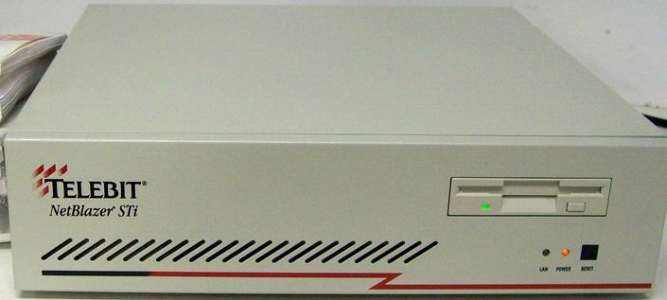
How were these delivered?
UUCP, SLIP, PPP – Typically dial-up to a stack of Courier modems connected to a Netblazer router in the PoP.
I no longer have a Netblazer.
My life is enriched because of this.
PRTsystems
www.prtsystems.ltd.uk
Notes:
Quite a large number of UUCP users initially. SLIP/PPP users sometimes had Centrex lines to provide 33.6k “leased line”.

Slide 9
How were these delivered?
UUCP, SLIP, PPP – Typically dial-up to a stack of Courier modems connected to a Netblazer router in the PoP.
CPE – None. Customer usually connected the modem at their end directly to a PC/Unix machine. Some did use routers but this was comparatively rare.
PRTsystems
www.prtsystems.ltd.uk
Notes:
It was usually cheaper to use a PC.
We had a 486 machine running FreeBSD 2.1 acting as both a mail server and a router at home; with a full time always-on connection at 33.6k courtesy of Cambridge Cable’s Centrex service.
There was a snake of 10base2 going all around the house but we had a LAN with a full-time Internet connection – and that was cutting edge geek technology.

Slide 10
How were these delivered?
ISDN – In most PoPs, a Cisco 2503 (or two) was pressed into action to terminate incoming ISDN calls.
CPE – An ISDN TA connected to a PC/Unix machine or there were some brave souls using Pipeline 25 ISDN routers.
PRTsystems
www.prtsystems.ltd.uk
Notes:
ISDN dial-on-demand challenges with Windows 95 DNS lookups for WORKGROUP.

Slide 11
How were these delivered?
ISDN – In most PoPs, a Cisco 2503 (or two) was pressed into action to terminate incoming ISDN calls.
We also had a device in Whitstable that bridged ISDN directly to Ethernet. To this day, I don’t think anyone knows who most of the customers were who used it.
PRTsystems
www.prtsystems.ltd.uk
Notes:
This thing did proxy ARP on the PoP LAN subnet and caused massive woe for everyone. It also lacked any form of useful diagnostics, didn’t handle caller ID properly, and the usual fix was to power cycle and hope. Migrating the customers was a nightmare due to poor records, lack of billing, and no IP assignment to track them by. Eventually we turned it off with a number of ‘unknowns’ still using it and waited to see who complained, nobody did.
When it was finally retired, it sat in the walkway beside network operations in Cambridge with a large “Kick me” label on it. Networks and customer support staff obliged enthusiastically.

Slide 12
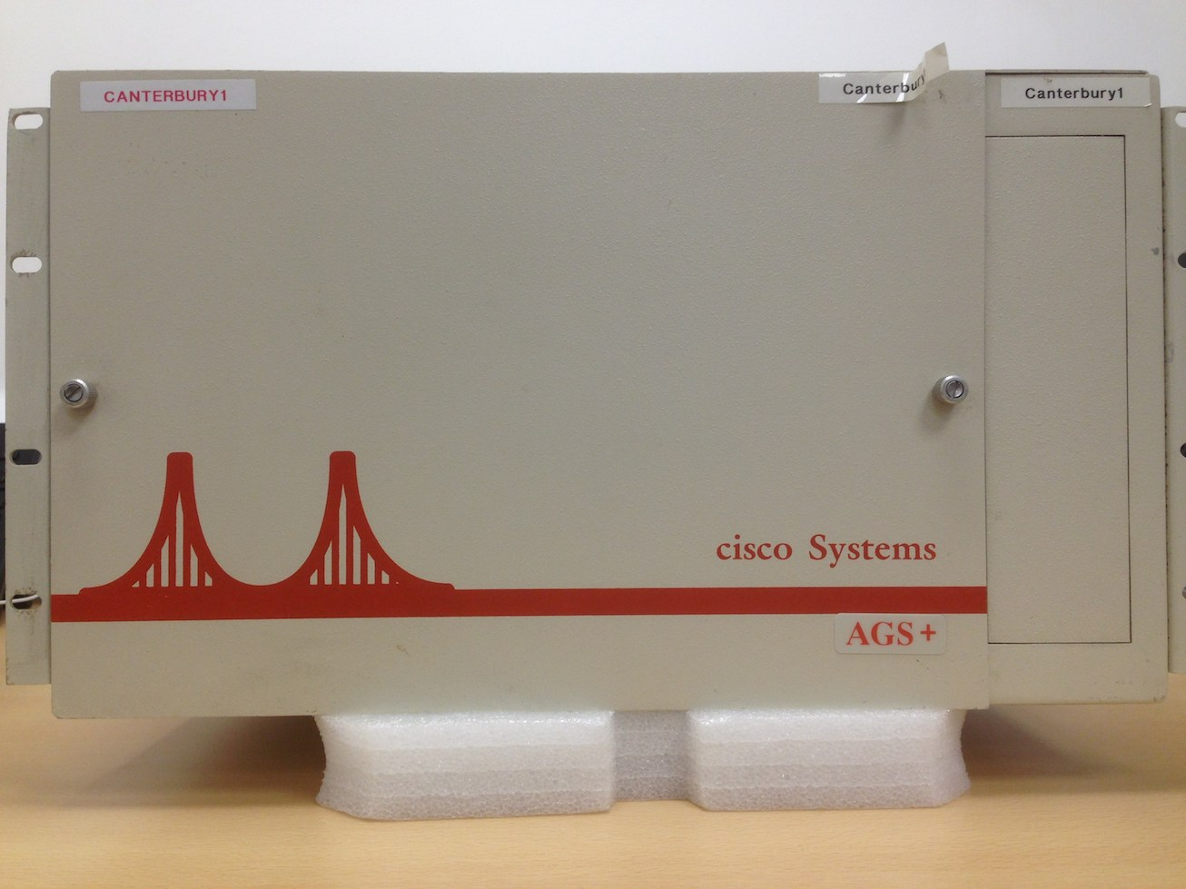
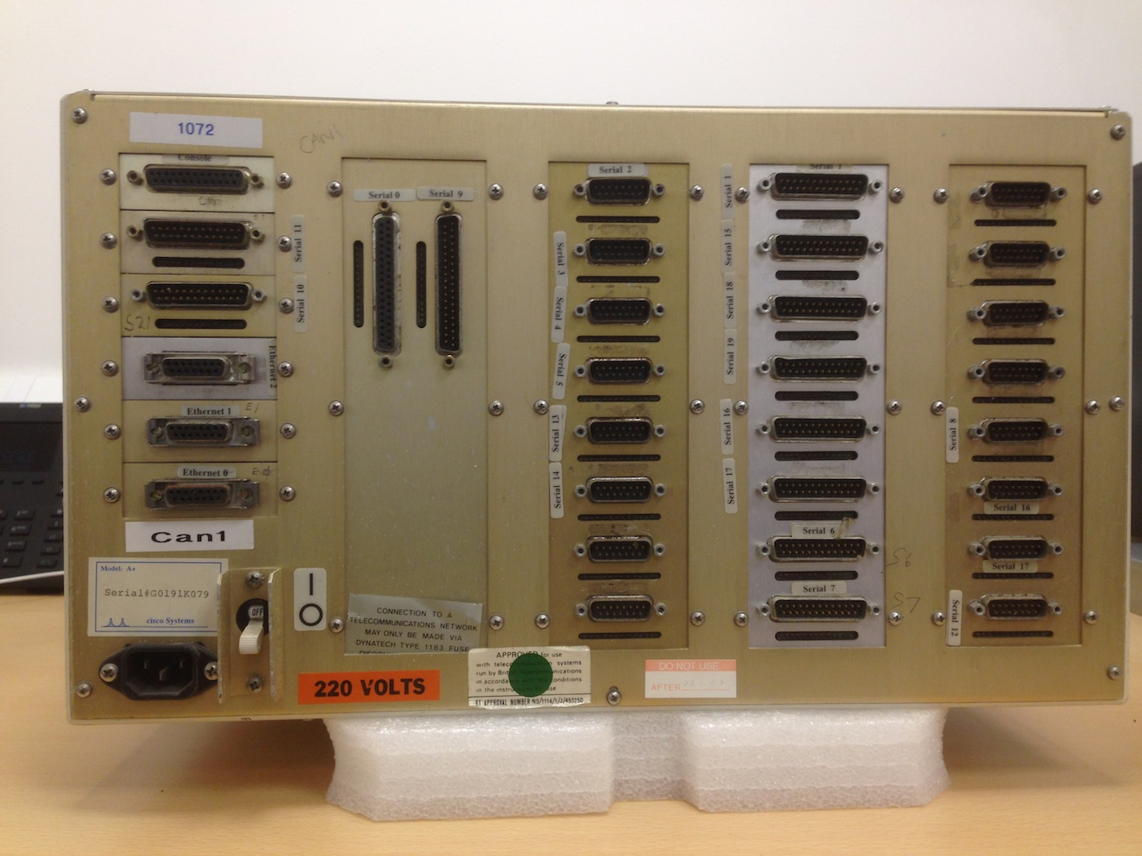
How were these delivered?
Leased Lines – Older PoPs had Cisco AGS+ routers with about 25 serial ports each, one per X.21 connection.
PRTsystems
www.prtsystems.ltd.uk
Notes:
Majority of customers were 64k. So there was also a BT shelf of NTUs.
Or, if it was a particularly disorganised small PoP, there were a pile of individual NTU 6As connected to the routers.
I did attempt to power canterbury1 up – but it smelt of burning electronics and nothing came out on the console, which is a shame.

Slide 13
How were these delivered?
Leased Lines – Newer PoPs had stacks of 2500s with a customer on each of the serial ports.
All interconnected with 10base2.
PRTsystems
www.prtsystems.ltd.uk
Notes:
And boy was there a lot of 10base2. The combination of that, and the thick Cisco serial cables made working in the back of a PoP rack like wrestling an anaconda.

Slide 14
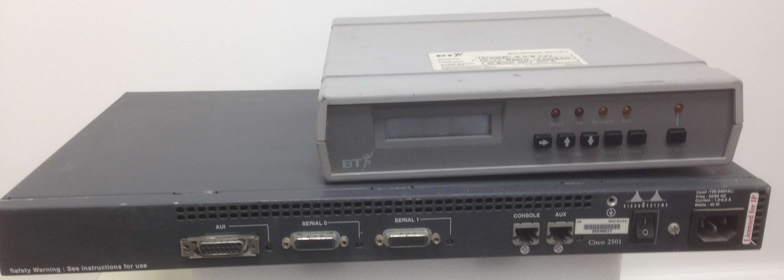
How were these delivered?
Leased Lines – Customers had a BT NTE and a router. Most of the time this was a 2501, however there were some surprises.
This was typical for most ISP’s leased-line customers.
PRTsystems
www.prtsystems.ltd.uk
Notes:
I can’t remember any of the surprises, but they were generally a pain to configure and had V.35 connectors. Why on earth did a serial interface need such huge pins?

Slide 15
WWWhat..?
Web hosting back then had its own challenges too.
No HTTP Host headers – therefore one IP address per website if you wanted your own domain.
Apache was bleeding edge, we used NCSA.
PRTsystems
www.prtsystems.ltd.uk
Notes:
This led to a lot of servers with a lot of secondary IP addresses.

Slide 16
EUNet GB Network
Sadly, we don’t have a map from 1995.
PoP locations: Aberdeen, Belfast, Birmingham, Bracknell, Bristol, Cambridge, Canterbury, Glasgow, Leeds, Letchworth, London, Manchester, Newcastle, Swindon.
384K link to EUNet Amsterdam.
PRTsystems
www.prtsystems.ltd.uk
Notes:
I can’t remember the routing protocol used; I have a nasty feeling that it may have been RIP, as the Netblazer’s didn’t (of course) support IGRP.

Slide 17
When I say PoPs…
EUNet PoPs fell into three basic categories:
The office at Whitstable.
A pair of precarious racks in TFM2.
A rack wedged into the back room of a compliant customer, who happened to want a leased line faster than 64k somewhere in the country where they wanted to locate a PoP.
PRTsystems
www.prtsystems.ltd.uk
Notes:
To be fair, I think this sums up most of the providers of the day!
The customer would normally get higher speed bandwidth but would end up sharing it with a number of others. I’m reminded too that >64k wasn’t actually a barrier to hosting a PoP sometimes.

Slide 18
The New: PSINet UK Services
Much of 1996 was spent migrating customers from the EUNet legacy network to PSI’s new shiny frame-relay network.
PSI’s UK network was concentrated on three primary PoPs: Cambridge, Telehouse and Energis (Park St)
PRTsystems
www.prtsystems.ltd.uk
Notes:
Having an underlying Layer-2 based network is something that stuck with me since then. Most other providers didn’t do this – and PSI milked the sales opportunities, especially as customers seemed obsessed with traceroute hops. Possibly because each one added another 10ms to the RTT.

Slide 19
PSINet UK Services
Dial up PSTN and ISDN numbers migrated to Energis, terminated on Ascend Max chassis with multiple E1s for incoming calls.
Migrating ISDN customers was a nightmare.
The Max was a temperamental beast.
PRTsystems
www.prtsystems.ltd.uk
Notes:
ISDN customers seemed at first glance to be fairly easy, but the vast majority had some non-standard oddity that involved us going to site with a router just to make it work and get them over to the new network.
Like many dialin solutions at the time, the maxes suffered from locked up channels, modems that sometimes didn’t want to work, and competing standards for >33k
UUCP was left on EUNet machines and subsequently retired a year or so later, blaming Y2K (without even checking).

Slide 20
PSINet UK Services
Leased line customers were delivered to the nearest physical PoP.
All customer connections via frame relay.
Terminated on Cascade BSTDX 9000 switch.
64k customers on E1 bearers.
128K-512K (and 1M) customers on X.21.
2M customers on E1 ports.
PRTsystems
www.prtsystems.ltd.uk
Notes:
Initially the leased line customers went either to Telehouse or Cambridge as they were the only two PoPs configured to accept BT circuits.
If I recall correctly, a 1M leased line was usually more expensive than a 2M, so weren’t sold very often.

Slide 21
PSINet UK Infrastructure
The three primary PoPs essentially consisted of two main components:
Cascade (later Ascend) 9000 switch.
Cisco 7507 router.
These were interconnected using HSSI connections (normally just the one).
PRTsystems
www.prtsystems.ltd.uk
Notes:
Telehouse had multiple switches and/or routers by 2000. I can’t remember what Cambridge had, but certainly in 1996 there was only one switch and router.
The redundancy was a bit light. The Cascade 9Ks were superbly reliable though, I can’t remember a major outage caused by one of them. Their weak spot was a 2.5” hard drive mounted on the management card PCB, but you only knew this when you wanted to reboot that card. Hopefully, this hadn’t happened to the other one as well.
HSSI stands for High Speed Serial Interface. In 1996, 45M was considered “High Speed”. HSSI cards for 7500s were ludicrously expensive.

Slide 22
Leased Line Configuration
CPE router was usually a Cisco 2501, connected to a BT NTU.
Frame relay PVC from customer router interface to PoP router’s HSSI port.
This appeared as a timeslot on an E1 bearer from BT (or as an X.21 port for >64k).
PRTsystems
www.prtsystems.ltd.uk
Notes:
Big issue was that aggregation of multiple leased-line customers was limited to a 2M circuit … there were a lot of those.

Slide 23
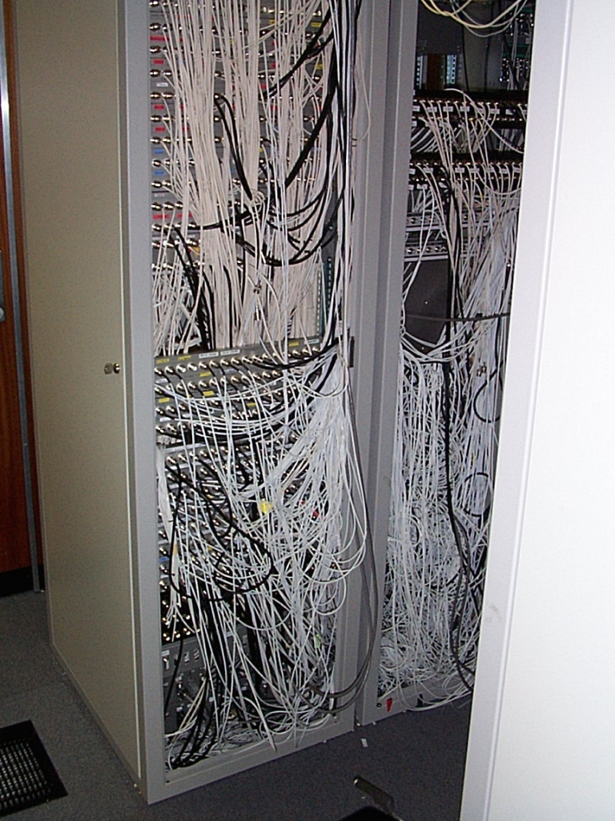
Leased Line Configuration
The main problem with BT not providing bearers faster than E1 were PoPs that looked like this.
Doing anything in there was hazardous.
PRTsystems
www.prtsystems.ltd.uk
Notes:
Each white cable is one half (tx and rx) of an E1 circuit. This photo is slightly later, circa. 1999.
How we longed to have more than 31 64k customers on one port. BT, however, were geared up for multiple E1s, so that’s what we got.
Coupled with the fact that they didn’t support 128k+ on bearers so they came across as individual X.21 connections.
Eventually this was sorted out around 2000/2001. And there was much rejoicing.

Slide 24
Leased Line Configuration
L3 routing between PoP router and customer router used RIPv1.
Which actually worked surprisingly well.
Not statically routing customers was one of those things that didn’t seem a big deal at the time, but was the Right Thing ™.
PRTsystems
www.prtsystems.ltd.uk
Notes:
Customer announced their LAN subnet to PoP, PoP announced a default back. There was an ACL to update to permit the PoP router to accept the route.
We did need to do some hard work going from classful to classless in 1997. Prior to this, you got a /24 for every leased line customer.
Some early ones even had a /16.
Anyone from RIPE listening, please close your ears now:
At least one ISDN dialup customer had a /16 – I know this because I was trying to work out how best to misappropriate it circa 2001, but never quite had the balls to try. At $10 per IP address, I wish I had.

Slide 25
Leased Line Configuration
It was all very well have L2 PVCs from customer to PoP router, however they were static and therefore never failed over elsewhere if there was a PoP router fault.
I don’t recall any multi-homed customers in the sense that we’d describe them today.
PRTsystems
www.prtsystems.ltd.uk
Notes:
Not, of course, that there was another PoP router to take over. In theory, a customer router could have had multiple PVCs going off in different (logical) directions – and in the US they sometimes did; using one PVC for Internet and another for point-to-point service.
We didn’t do this in the UK.
The important matter of keeping frame relay DLCIs unique was entrusted to a text file called “fr-bible.txt” that was under SCCS source control.
The switches were managed from an NMS running a recalcitrant HP Openview installation on a Sparc 20. This, of course, looked pretty but wasn’t exactly a joy to work with. By sheer chance, it was next to my desk; and I frequently just used it as another convenient-to-access machine. The US folks all treated it with respect bordering on reverence and were appalled by my heretic attitude towards it.
Each PVC had a name, usually related to the customer, so: For example, “eunet-chadwyk” was the legacy EUNet Chadwyk Healey customer in Cambridge.
For reasons known to someone, somewhere, the PVC for W S Atkins Ltd was named “eunet-bagpuss”.
I don’t know how I still know that fact.
Yes, there was of course a psi-prt which was my connection to home, which by 1998 had become a 128k leased line. But that’s a different story.

Slide 26
Virtual PoPs
Early customers for Manchester, Edinburgh and Birmingham were delivered to their own routers (2501s!) in Cambridge via an X21 cable clocked at 2M.
At critical mass, the whole lot became a 2M leased line and the PoP moved to the correct city, and there were a lot of A-end shifts.
PRTsystems
www.prtsystems.ltd.uk
Notes:
This virtualization initially seemed mad, but made a lot of sense.
When n times 64k long haul got more expensive than 1x 2M, the pop moved. A Cascade switch was, of course, required; as was a proper router – but at PSI capital kit was always available as a hand-me-down from the US.

Slide 27
Troubleshooting (part 1)
I learned some things the hard way:
Typing ‘debug all’ on the Telehouse core 7507 can liven up your afternoon no end.
Multiple IGPs with lots of redistribution between them also leads to tears before bedtime.
Customers don’t always tell the truth.
PRTsystems
www.prtsystems.ltd.uk
Notes:
I didn’t know what debug I might have needed, and seeing all was an option, it sounded like a good plan. Luckily IOS at that time was unstable enough that this crashed the router, which rebooted, and normal service was back about 10 minutes later – more by luck than judgement or engineering.
Especially when the redistribution didn’t have a route-map.
Typical issue was customer (who had enable access to their CPE 2501) would implement a firewall (well, an ACL on serial0) but no allow RIP or something else important (permit tcp established was the other one). This, of course, broke their connection and they would never fess up to it. They then had to fax you the router config (no E-mail working) so you could tell them what to fix.

Slide 28
Troubleshooting (part 2)
Some things I was very glad to bear no responsibility for:
Shutting down the old 384K circuit to Amsterdam, only to have 6x ISDN B channels come up because it went down. For a month.
When /var/named on strand.britain.eu.net corrupted without a viable backup. The resulting fsck –y ran all afternoon.
PRTsystems
www.prtsystems.ltd.uk
Notes:
The bill was large. Remember the 000 international prefix for uncompressed ISDN.
Strand was the .co.uk primary authoritative nameserver. Who knows how many domains vanished into the bit bucket that day.

Slide 29
Challenges
The various EUNet service machines were all cross-mounted to each other in a Gordian knot of NFS.
If one machine hung, that was it; they all gradually ground to a halt.
We were all happy that services were migrating away from these boxes.
PRTsystems
www.prtsystems.ltd.uk
Notes:
Just descending through three levels of the directory hierarchy could easily involve three different machines.
These machines were key service machines (nelson, ben, eros, fleet, marble) too, serving customer DNS, mail and web.
I sometimes log the traffic destined for 192.91.199.4 (nelson.britain.eu.net) and it does occasionally *still* receive DNS requests. There are people out there who have domains delegated to a nameserver decommissioned 18 years ago!

Slide 30
More Challenges
PSINet US had their own, unique, ideas.
We often took no notice of their diktats – as unlike other parts of the group, PSINet UK actually made a profit.
Remember folks, AS174 has been the go-to AS for peering spats since the early 1990s.
PRTsystems
www.prtsystems.ltd.uk
Notes:
We couldn’t use any hardware or software not properly tested and certified in the US. Sounds sensible, but the certification process took months or quite possibly years.
Of all the other worldwide offices, I think PSINet UK remained the only one that made money. This was mainly because when the US said things like “You need to spend X million on this new hardware” we replied “No we don’t”.
Although that did bite us too as we relied on their unwanted, unloved hand-me-downs, and thus had quite rough Sun Sparc 20 clones whose reliability wasn’t exactly stellar in production for critical service machines.
AS174 – Nearly new AS with two careful owners.

Slide 31
The Network
By late 1996, most key PoP interconnects were 2M. Legacy EUNet links 64k-512k.
Link to the USA were 2x 1.5M, plus the 10M borrowed from Demon.
Link to Amsterdam was 1M.
2x LINX connections at 10M each.
PRTsystems
www.prtsystems.ltd.uk
Notes:
By October 1996, only 5 legacy UK EUNet PoPs were still to be migrated (Canterbury not included).
Demon ordered a T3 to the USA but had nowhere to connect at the US end – so we said they could terminate it in our NY PoP in return for 10M of bandwidth. Lacking any other mechanism to split the circuit, we had a GRE tunnel for a while – with MTU problems aplenty.

Slide 32
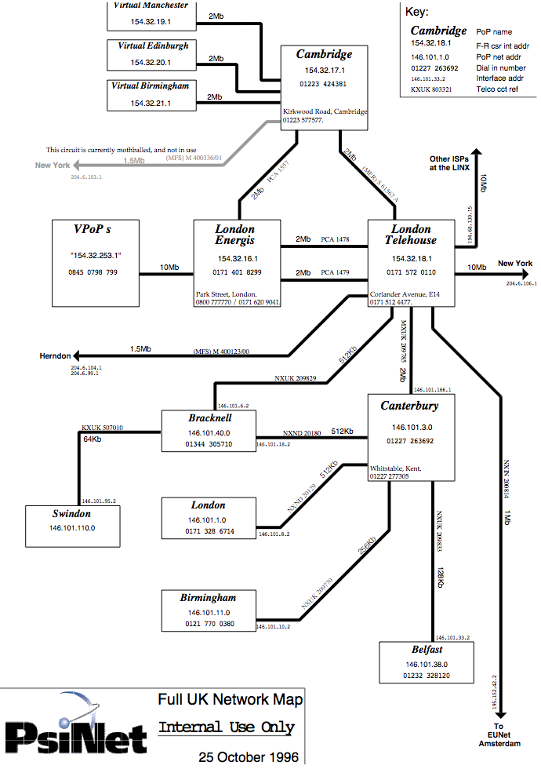
The Network (October 1996)
PRTsystems
www.prtsystems.ltd.uk
Notes:
By October 1996, only 5 legacy UK EUNet PoPs were still to be migrated (Canterbury not included).
There was an amusing BT outage late ‘96 that took out the NXNDs to London, Bracknell and the MXUK to Canterbury – total of 3x 512k circuits + 1x 2M.
Anyone who could answer the question was away from the office, so I played guess the circuit ref with BT faults as we wanted to get them all reported to have the service credits.
The person wasn’t allowed to tell me the reference but successfully guided me to it in several cases.

Slide 33
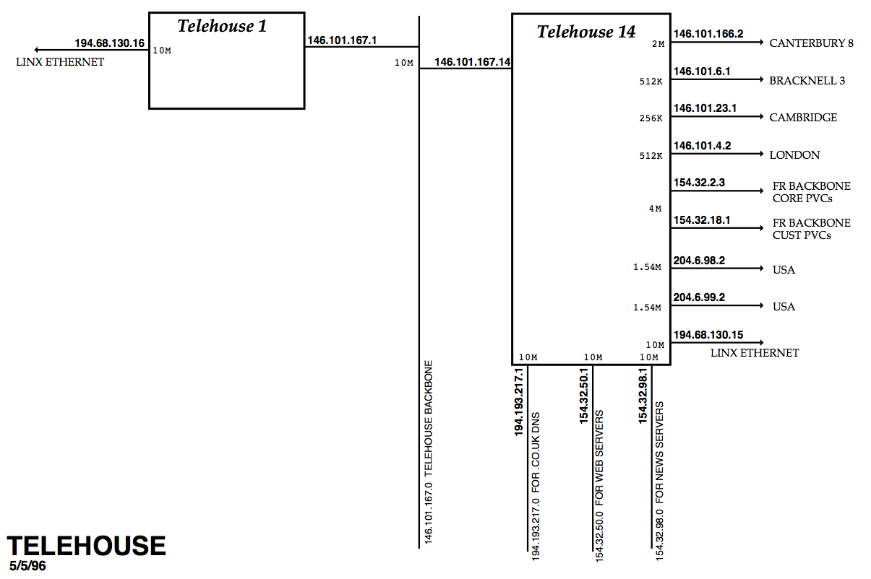
Telehouse PoP (1996)
PRTsystems
www.prtsystems.ltd.uk
Notes:
This diagram isn’t complete, there were a number of 2501s and 2503s (connected together with 10base2) also on that “Telehouse Backbone” LAN serving customers.
Telehouse14 was the 7507 with FR customers; Telehouse1 was a 2514.
I remember closing the EUNet Telehouse TFM2 PoP on New Year’s eve 1995 (I still made it back to Sussex for the party on time), I think most of the 2500 routers I own came from there – there were several BT NTUs connected back-to-back under the floor that we hoped Telehouse wouldn’t notice for a few weeks. They didn’t.

Slide 34
Telehouse PoP (1996)
Now you may be thinking “Telehouse1, that sounds like a big important router”…
Please don’t. This is/was Telehouse1.
PRTsystems
www.prtsystems.ltd.uk
Notes:
I’m sure that it wasn’t a 2514 for very long after that, I suspect 6 months later it had been retired.

Slide 35
DNS
PSINet inherited the primary DNS for .co.uk
It would have been very naughty to just add zones, so I’m sure we never did.
A lot of .co.uk domains were submitted to the naming committee the day before Nominet took over though.
Urgently requesting a reload of org.uk in the middle of the working day.
PRTsystems
www.prtsystems.ltd.uk
Notes:
I certainly didn’t. I didn’t have root access to ns0.
The Naming Committee received requests and then cogitated and deliberated and either approved or rejected them. With no time to reject, they all automagically approved at midnight. I still have quite a few of those domains…
It was a little like being told off at school, when a US-based VP discovered that there was a website detailing who had left the company and how much happier they were.
Unfortunately the domain in question was delegated to a nameserver of mine and this made it unambiguously clear who was in the frame.
We quickly removed all traces of all nameservers in the zonefile, and refreshed all of PSINet’s resolvers; but the zone had a 24 hour TTL and still showed up if you asked Nominet.
Luckily in those halcyon days of 1997, asking Nominet to reload org.uk in the middle of the day to avoid a incurring the wrath of a senior company executive was a perfectly acceptable gambit, and they obliged.
By the time he came upstairs and typed www.marmite.org.uk into his browser, it had vanished.

Slide 36
Usenet News
What a bandwidth and disk space hog that was/is/ever shall be.
Customers would frequently demand a full feed on a 64k leased line and then complain bitterly about their (lack of) bandwidth.
Moving news servers raised blood pressure.
PRTsystems
www.prtsystems.ltd.uk
Notes:
Also note that some of the higher bandwidth consumers of the alt.binaries groups turned out to be members of staff when we performed log analysis; there was even a quite secret mailing list internally that provided a list of top-ten, ahem, clients for downloading usenet news.
And as these customers would download news overnight, they’d often cause enough ICMP packet loss to trigger out-of-hours pagers as well.
When the city and bits of docklands had the “ring of steel”, we were stopped once by the police near Canary Wharf travelling from Cambridge to Telehouse late one evening.
It suddenly dawned on me whilst showing the police that we just had some Internet servers in the boot of the car that these almost certainly contained images of very dubious legality.

Slide 37
Servers
Defaults then were not security conscious:
SunOS 4 came with no shadow password file, rsh enabled and root’s rhosts file consisted of ‘++’.
SSH still being written, telnet was the only option.
TCP wrappers was the pinnacle of filtering.
Router-interface ACLs were the only protection, slowed the router down no end, and they weren’t stateful.
Luckily, botnets hadn’t been invented yet!
PRTsystems
www.prtsystems.ltd.uk
Notes:
++ in .rhosts basically says “Come on in without a password”.
Everything to enhance security was also an add-on to the OS in those days too.

Slide 38
Automation
Configuration stored in loosely-structured text files (no open source SQL yet).
Mixture of sed, awk, perl created DNS zonefiles, mail server configurations and RADIUS entries; and ticketing was CLI-based written in awk.
UUCP was used to distribute to service machines for a long time (eventually replaced with SSH).
PRTsystems
www.prtsystems.ltd.uk
Notes:
Everything was shell-script driven on the internal staff server where everyone had a shell account, and used it.
Want to change the DNS? zonedit.
Want to update a ticket? phonetkt.
Want to change your RADIUS password? radedit
Web based CGI tools were a way off. We still had all internal documentation stored in a local gopher server.

Slide 39
Outages
Early one morning the Letchworth PoP went down.
We called them to discover that it had been stolen in a burglary overnight.
We’d had a number of power cuts, so at great expense part of the loading bay was set aside for a generator and this was duly installed.
The next time the power failed, the PoP UPS blew up.
After that, the utility power was rock solid!
PRTsystems
www.prtsystems.ltd.uk
Notes:
I wonder if they had any luck selling a bunch of worn-out networking equipment down the pub. This definitely predated Ebay and quite possibly, predated Yahoo auctions too.
We had to tidy out the rubbish in the warehouse, which was great for people like me who wanted to add to their collection. I think, in fact, that’s where the Netblazer previously referred to came from!
The UPS explosion was somewhat arresting. Everything in the PoP was powered from it, and it was awfully quiet in there – apart from the sound of many CO2 extinguishers being discharged into it as there was a lot of smoke and smell of ionized badness.
Many extension leads from sockets out in the corridor to power critical kit whilst we worked out what to do with the UPS.
This is the reason why, even now, I connect one feed of dual-powered kit to the critical UPS/generator backed supply and the other to a boring, normal, socket. Unless I have true UPS/Generator redundancy (although you can’t guarantee that of course, regardless of what your DC tells you).
They finally sorted out the power supply to the Cambridge Science Park and Kings Hedges Road by installing new HV gear.

Slide 40
And Finally…
I wasn’t the only one using Mustelidae-based placeholders:
cambridge#show conf
Using 18179 out of 130048 bytes
...
!
interface Ethernet0/0
description stoat
ip address 194.193.150.1 255.255.255.0 secondary
ip address 154.32.105.1 255.255.255.0 secondary
ip address 154.32.106.1 255.255.255.0 secondary
ip address 193.112.253.1 255.255.255.0 secondary
ip address 194.223.203.1 255.255.255.0 secondary
ip address 154.32.111.1 255.255.255.0 secondary
ip address 195.152.104.1 255.255.255.0 secondary
ip address 154.32.109.25 255.255.255.252 secondary
ip address 154.32.110.5 255.255.255.252 secondary
ip address 154.32.49.1 255.255.255.0
ip access-group 110 out ip route-cache sse
PRTsystems
www.prtsystems.ltd.uk
Notes:
This was the Cambridge 7507. It was running IOS 10.3 and boasted one 6x AUI 10M Ethernet line card and one 1x HSSI line card.
We did love to overlay multiple subnets on one physical LAN. It makes me twitch to look at configs like this!

Slide 41
And Finally…
I wasn’t the only one using Mustelidae-based placeholders:
cambridge#show conf
Using 18179 out of 130048 bytes
...
!
interface Ethernet0/0
description stoat
ip address 194.193.150.1 255.255.255.0 secondary
ip address 154.32.105.1 255.255.255.0 secondary
ip address 154.32.106.1 255.255.255.0 secondary
ip address 193.112.253.1 255.255.255.0 secondary
ip address 194.223.203.1 255.255.255.0 secondary
ip address 154.32.111.1 255.255.255.0 secondary
ip address 195.152.104.1 255.255.255.0 secondary
ip address 154.32.109.25 255.255.255.252 secondary
ip address 154.32.110.5 255.255.255.252 secondary
ip address 154.32.49.1 255.255.255.0
ip access-group 110 out ip route-cache sse
PRTsystems
www.prtsystems.ltd.uk
Notes:
This was the Cambridge 7507. It was running IOS 10.3 and boasted one 6x AUI 10M Ethernet line card and one 1x HSSI line card.
We did love to overlay multiple subnets on one physical LAN. It makes me twitch to look at configs like this!
There were no brass goats, however.

Slide 42
Any Questions?
This presentation, diagrams and the router configurations I managed to locate can be found at:
http://www.prt.org/history
Happy Birthday
Your Majesty
PRTsystems
www.prtsystems.ltd.uk
Notes:
Her Majesty Elizabeth the Second, by the Grace of God of the United Kingdom of Great Britain and Northern Ireland, and of Her other Realms and Territories Queen, Head of the Commonwealth, Defender of the Faith

Slide 43
Thank you
Paul Thornton
paul@prtsystems.ltd.uk
UKNOF34
Manchester
21 April 2016
PRTsystems
Notes:
There are others who can tell the EUNet GB story better than I, and I hope this presentation hasn’t offended those who built it too much.
Hey, PSI thought it was worth £2.5M so lets not quibble!

